Slide 1

Predicting Nonlinear Systems through Koopman-Based Autoencoder
Gaurangee Parashar
211EE228
Rajashri Varadaraj
211EE137

Slide 2
Introduction
Koopman-based Autoencoders combine principles from Koopman operator theory and deep learning to transform nonlinear dynamical systems into linear representations in a learned latent space.
The Koopman operator is a linear but infinite-dimensional operator that governs the evolution of observables in nonlinear systems, enabling linear analysis of inherently nonlinear dynamics.
Autoencoders are neural networks that learn compressed representations of data, making them suitable for capturing underlying system dynamics through unsupervised learning.
By integrating Koopman theory with autoencoders, the system learns an encoder that maps nonlinear input states into a latent space where dynamics evolve linearly, and a decoder that reconstructs the original states.

Slide 3
Problem Statement
Conventional methods for modeling nonlinear dynamical systems often struggle with accurate prediction and efficient representation due to their inherent complexity and lack of linear structure. These limitations hinder the scalability and interpretability of models applied to real-world dynamical systems. Koopman operator theory, which enables linear representation of nonlinear dynamics through observable functions, offers a powerful framework to overcome these challenges.
This work aims to develop a Koopman-based autoencoder that learns a latent space where nonlinear system dynamics evolve linearly, enabling both efficient reconstruction and long-term prediction. By leveraging this approach, the system achieves improved interpretability, stability, and forecasting performance for complex nonlinear systems.

Slide 4
Methodology
KOOPMAN MATRIX
Koopman theory provides a framework to analyze nonlinear dynamical systems using a linear operator called the Koopman operator that acts on a space of observables.
Unlike the original nonlinear system, the Koopman operator captures the dynamics linearly in an infinite-dimensional space.
In practice, we approximate this operator with a finite-dimensional Koopman matrix using learned or known observables.

Slide 5

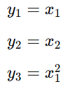
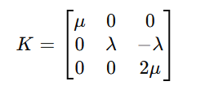
Here, we have two equations that describe a non-linear system:
Now, we transform these equations into a set of observables:
From the above set of observables, we obtain the koopman matrix (K) as follows:

Slide 6
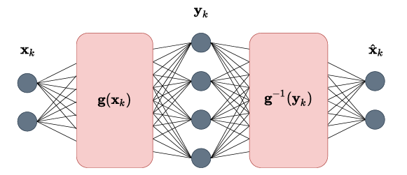
AUTOENCODER
An autoencoder is a special type of neural network with two main components: an encoder and a decoder.
The network as a whole is trained to encode an input into a code and output a reconstruction of the input from this code, that should be as close as possible to the original input.
It is trained by back-propagation, using the mean-squared error between reconstruction and original input as loss function

Slide 7
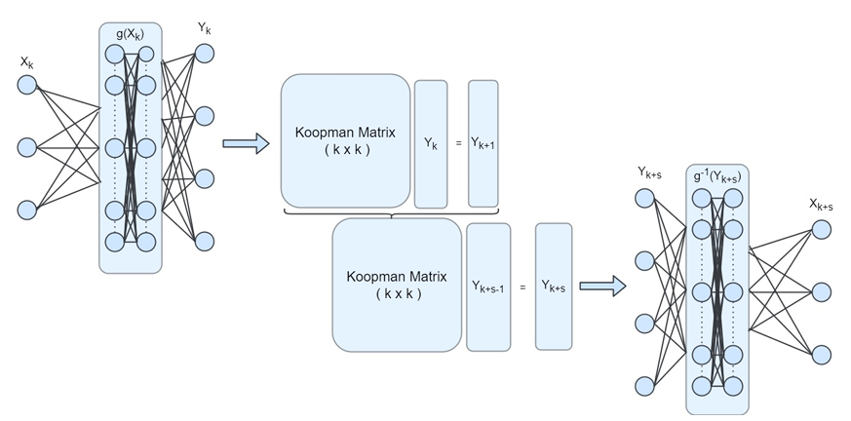
KOOPMAN BASED AUTOENCODER

Slide 8
The encoder network learns to transform the original state x into an embedding of observables yₙ = g(xₙ).
To perform prediction with the model, a linear transformation of the augmented state yₙ with the approximated Koopman operator K is performed which results in yₙ₊₁ .
The decoder network learns to reconstruct the original state from this embedding as closely as possible by the inverse transformation x’ = g⁻¹(yₙ).
To train the model, three different loss functions are used:
Reconstruction accuracy (Lrec)
Prediction accuracy of the linear dynamics (Llin)
Accuracy of future state prediction (Lpred)

Slide 9



Reconstruction accuracy is computed by finding the mean squared error (MSE) between the original input x and the output of the decoder g⁻¹(g(x)).
Linear prediction loss is the average mean squared error over S future steps between the true lifted states g(xₖ₊ₛ) and the predicted lifted states obtained by applying the Koopman matrix K repeatedly to the encoded initial state g(xₖ)
Prediction loss in the original state space is the average mean squared error over S steps between the true future states xₖ₊ₛ​ and the decoded predictions.

Slide 10

These losses are combined into one loss function, weighted by the hyperparameters. Furthermore, the final loss function contains a term for l2 regularization, i.e. the sum of squares of the network weights W.
The complete loss function has the form:
Here, α1 = 1.0 α2 = 50.0 α3 = 10.0 α4 = 1e-6

Slide 11
SYSTEMS USED FOR MODEL TESTING AND TRAINING
PENDULUM SYSTEM
The dynamics of a simple pendulum without damping or driving forces at any time t is represented by two state variables, x1 and x2.
x1: Angular position of the pendulum (in radians).
x2: Angular velocity (rate of change of angle).
The equations describing the dynamics are given below:
x˙1​ = x2
x˙2​​ = −(l/g​)sin(x1​)
where, g = gravitational acceleration (typically 9.81 m/s²)
l = length of the pendulum

Slide 12
A dataset of 800 training samples, 200 validation samples and 100 testing samples was generated by using the Runge-Kutta method. Each sample consists of 100 time steps of system evolution. Initial conditions were sampled uniformly in a range of [ 2.0,2.0] for each state dimension.
The encoder contains 2 hidden layers with 30 neurons each and ReLU activation followed by an output layer of 3 neurons.
Koopman matrix is of size 3 x 3 .
The decoder contains 2 hidden layers with 30 neurons each and ReLU activation followed by an output layer of 2 neurons.
The training was done for 20 epochs.
Prediction was done for 30 steps into the future.

Slide 13
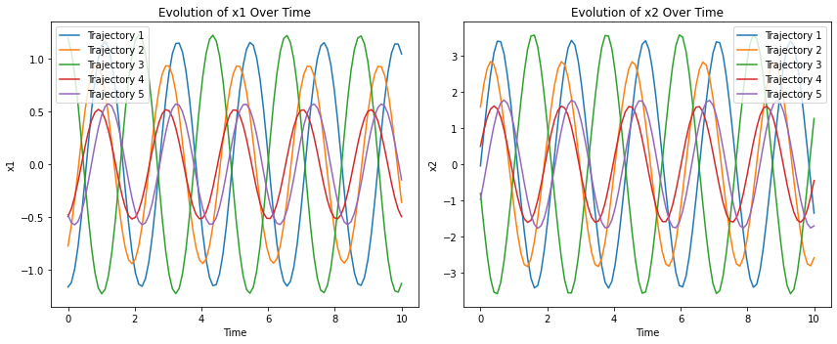
Evolution of state variables x1 and x2 with time

Slide 14
2. LORENTZ SYSTEM
The dynamics of the Lorenz system, a classical example of a chaotic nonlinear system for modelling atmospheric convection, is described at any time t by three state variables: x, y, and z.
x: Represents the rate of convection.
y: Represents the horizontal temperature variation.
z: Represents the vertical temperature variation.
The equations governing the Lorenz system are given below:
x˙=σ(y−x) y˙=x(ρ−z)−y z˙=xy−βz
where:
σ = Prandtl number (typically 10)
ρ = Rayleigh number (typically 28)
β = geometric factor (typically 8/3)

Slide 15
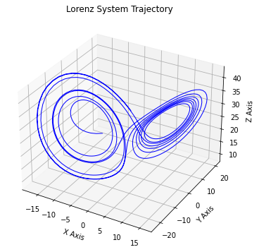
Evolution of state variables x, y and z with time

Slide 16
3. ROSSLER SYSTEM
The dynamics of the Rössler system, a simplified model for continuous-time chaotic behavior, is described at any time t by three state variables: x, y, and z.
x: Represents the system's primary oscillator.
y: Acts as a damping or modulation variable.
z: Introduces nonlinear feedback responsible for chaos.
The equations governing the Rössler system are given below:
x˙=−y−z y˙​ =x+ay z˙=b+z(x−c)
where:
a=0.2: a damping parameter
b=0.2: a constant bias
c=5.7: a nonlinearity control parameter

Slide 17
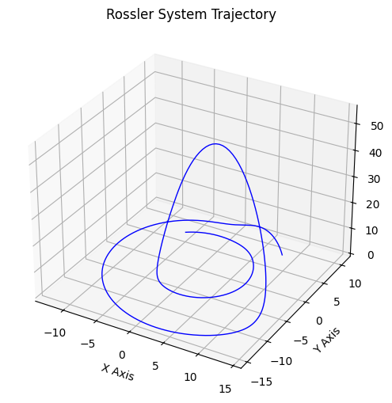
Evolution of state variables x, y and z with time

Slide 18
4. CHEN SYSTEM
The dynamics of the Chen system, a chaotic system structurally similar to the Lorenz system but with distinct behavior, is described at any time t by three state variables: x, y, and z.
x: Reflects the system's state in the x-direction.
y: Influenced by both linear and nonlinear interactions with x and z.
z: Incorporates bilinear coupling from x and y.
The equations governing the Rössler system are given below:
x˙=a(y−x) y˙​=(c−a)x−xz+cy Z˙=xy−bz
where:
a=35: system gain
b=3: damping coefficient
c=28: nonlinearity parameter

Slide 19
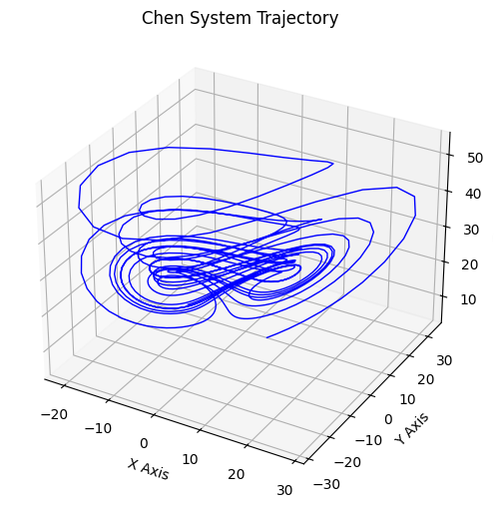
Evolution of state variables x, y and z with time

Slide 20
A dataset of 800 training samples, 200 validation samples and 200 testing samples was generated by using the Runge-Kutta method. Each sample consists of 256 time steps of system evolution. Initial conditions were sampled uniformly in a range of [ -20,20] for x and y
and [10,40] for z.
The encoder contains 2 layers. First layer has 500 neurons and ReLU activation and second layer has 32 neurons.
Koopman matrix is of size 32 x 32 .
The decoder contains 2 layers. First layer has 500 neurons and ReLU activation and output layer has 3 neurons.
The training was done for 20 epochs.
Prediction was done for 256 steps into the future.

Slide 21
5. SYNTHETICALLY GENERATED DATA FOR FUEL CELL SYSTEM
The synthetic dataset for the fuel cell stack voltage was generated by simulating the voltage behavior of a Proton Exchange Membrane Fuel Cell (PEMFC) over time.
The voltage decay was modeled with an exponential decay function, where the initial voltage was set to 50V and the decay rate was 0.02. Random noise with amplitude 0.5 was added to simulate the natural fluctuations that occur in real-world voltage measurements.
V(t)=V0​⋅e−λt+η(t)
Where:
V(t): Voltage at time t
V0​=50: Nominal (initial) stack voltage
λ=0.02: Exponential decay rate
η(t)∼N(0,σ2): Additive Gaussian noise with standard deviation σ=0.5
t: Time (from 0 to 200 seconds)

Slide 22
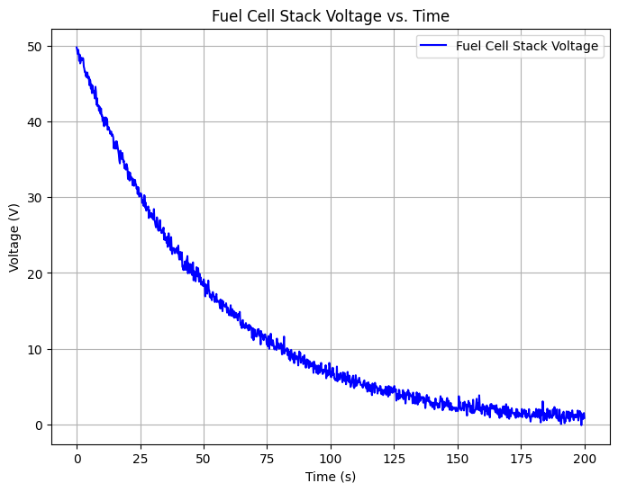
Evolution of Generated Fuel Cell Stack Voltage with time

Slide 23
6. IEEE 2014 CHALLENGE DATA
The IEEE 2014 Data Challenge dataset focuses on estimating the remaining useful life (RUL) of a Proton Exchange Membrane Fuel Cell (PEMFC). This dataset includes temporal and frequential data from fuel cell stacks under both normal and accelerated aging conditions. The main goal of the dataset is to predict the state of health (SoH) of the fuel cells and estimate their remaining useful life.
The dataset includes multiple variables, with the stack voltage being the primary variable used in this study. The voltage data was first cleaned using the Local Outlier Factor (LOF) method to remove any extreme outliers that could skew the training process

Slide 24
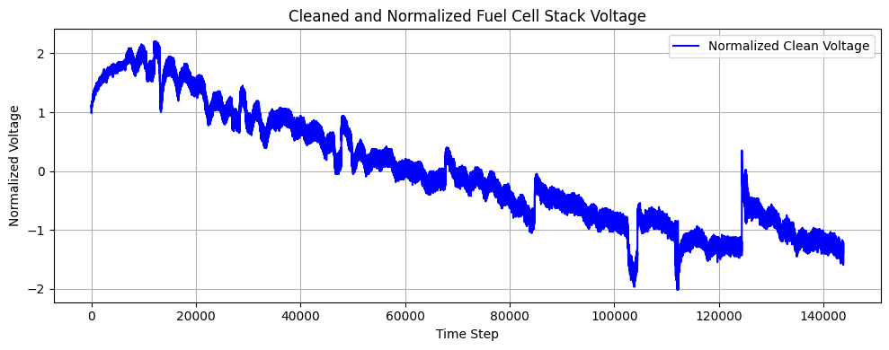
Evolution of Real Fuel Cell Stack Voltage with time

Slide 25
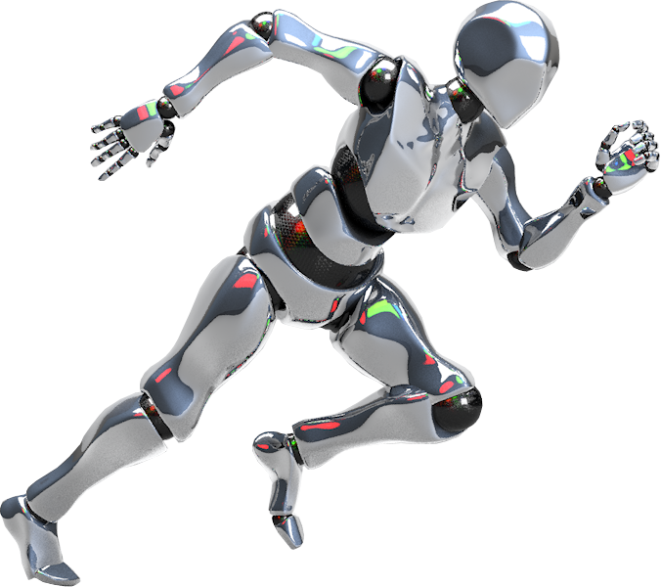
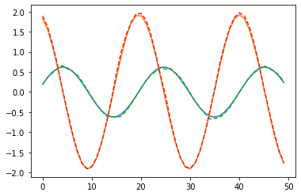
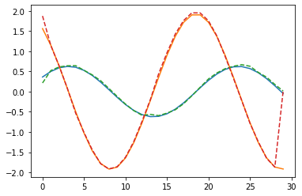
RESULTS
PENDULUM SYSTEM
Reconstruction plot
(Dotted lines - Reconstructed plot
Solid lines - Ground truth)
Prediction plot
(Dotted lines - Predicted plot
Solid lines - Ground truth)

Slide 26
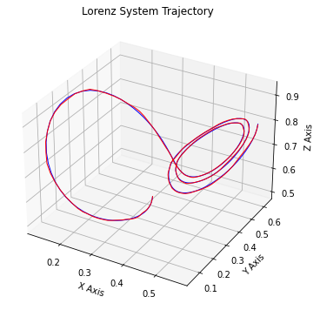
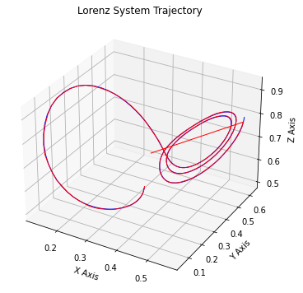
2. LORENTZ SYSTEM
Average test loss:
0.445
Average reconstruction loss:
0.0024
Average prediction loss:
0.044
Reconstruction plot
(Red - Reconstructed plot
Blue - Ground truth)
Prediction plot
(Red - Predicted plot
Blue - Ground truth)

Slide 27
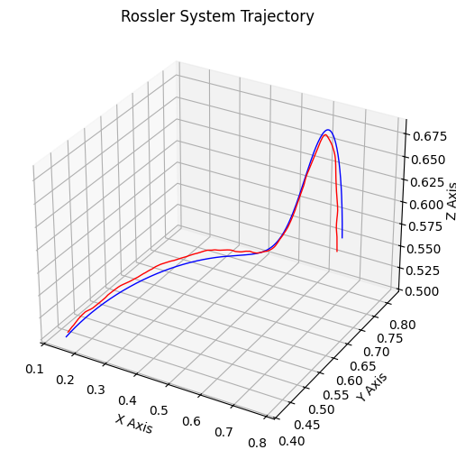
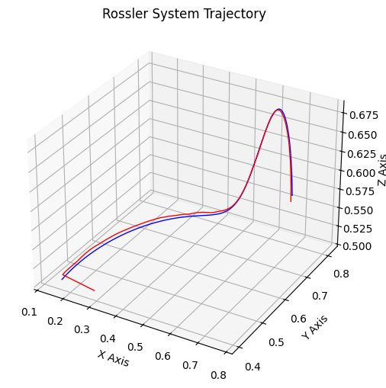
3. ROSSLER SYSTEM
Reconstruction plot
(Red - Reconstructed plot
Blue - Ground truth)
Prediction plot
(Red - Predicted plot
Blue - Ground truth)

Slide 28
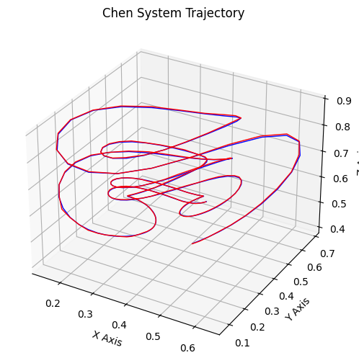
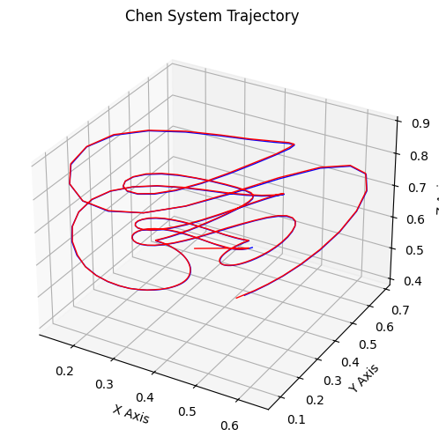
4. CHEN SYSTEM
Average test loss:
0.2186
Average reconstruction loss:
0.00080
Average prediction loss:
0.02178
Reconstruction plot
(Red - Reconstructed plot
Blue - Ground truth)
Prediction plot
(Red - Predicted plot
Blue - Ground truth)

Slide 29
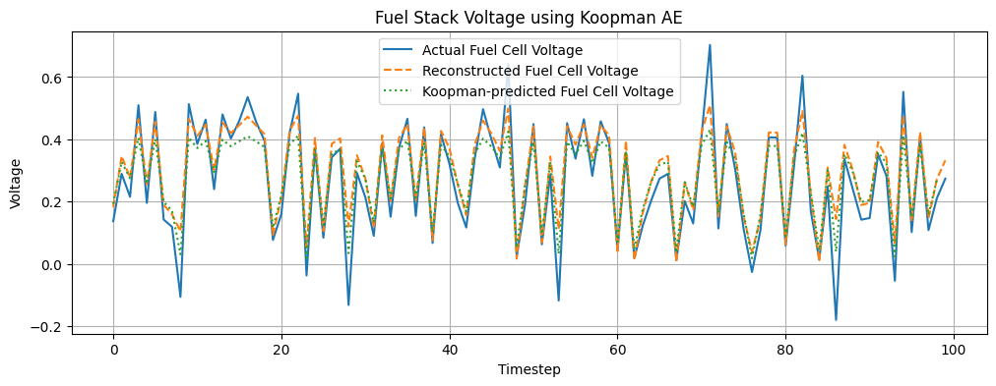
5. SYNTHETIC FUEL CELL SYSTEM
Average prediction loss:
0.0553
Average test loss:
0.5572
Average reconstruction loss:
0.0041

Slide 30
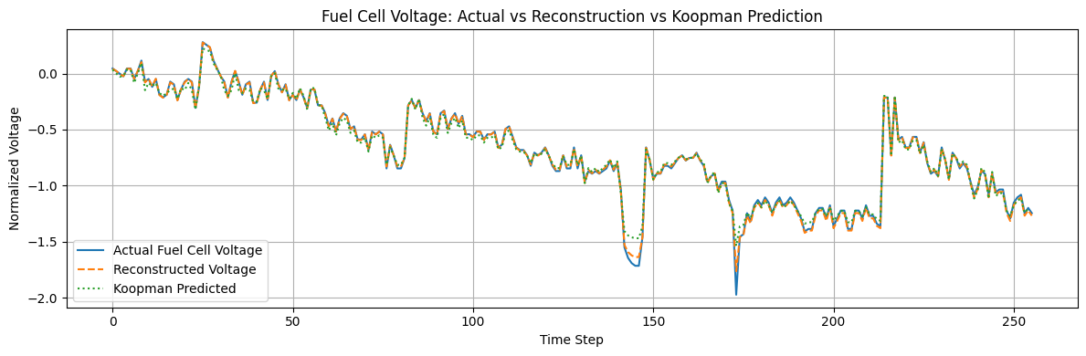
6. IEEE 2014 CHALLENGE DATA
Average prediction loss:
0.0235
Average test loss:
0.2353
Average reconstruction loss:
0.00035

Slide 31
Thank You!

